Slide 1



Risque de Crédit
Octobre 2022

Slide 2




Risque de Crédit | Introduction
La banque accorde des crédits à ses clients
Une proportion des crédits vont faire défaut
Les crédits en défaut vont enregistrer des pertes
La banque doit constituer des provisions
Modèles Scorcards
Modèles PD
Modèles LGD et EAD
Expected Credit Loss
=
PD × EAD × LGD
2
2

Slide 3
Risque de Crédit | Introduction
Probabilité de Défaut
(PD)
Total Exposé
(EAD)
Taux de Perte en cas de Défaut
(LGD)
Perte Attendue
(ECL)
3
3

Slide 4
Risque de Crédit | Introduction
Default: which is a discrete state for the counterparty—either the counterparty is in default or not. This occurs with some probability of default (PD). probability of default per rating grade gives the average percentage of obligors that default in this rating grade in the course of one year.
Credit exposure (CE): which is the economic or market value of the claim on the counterparty. It is also called exposure at default (EAD) at the time of default. EAD gives an estimate of the amount outstanding (drawn amounts plus likely future drawdowns of yet undrawn lines) in case the borrower defaults.
Loss given default (LGD): which represents the fractional loss due to default. As an example, take a situation where default results in a fractional recovery rate of 40% only. LGD is then 60% of the exposure. LGD gives the percentage of exposure the bank might lose in case the borrower defaults. These losses are usually shown as a percentage of EAD, and depend, amongst others, on the type and amount of collateral as well as the type of borrower and the expected proceeds from the work-out of the assets.
4
4

Slide 5
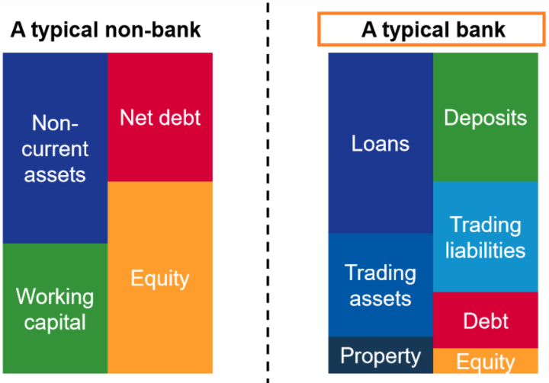
Risque de Crédit | Introduction
5
5

Slide 6
Risque de Crédit | Introduction
There are three main reasons explaining why regulations are in place for banks:
Fragile banking functions: In banking, the deposits received from households are considered as liabilities while loans offered constitute as its assets. Therefore, the bank’s balance sheet largely consists of liquid liabilities and illiquid assets
Presence of systemic risk: Financial institutions and banks that are huge and highly interconnected impose systemic risk to the banking system. A default by a bank can lead to the default of its creditor banks on their own counterparties and so on.
Protection of depositors: The depositors, being the creditors of a bank are usually not well informed on the bank’s investment activities. Moral hazard may emerge when banks engage in investments that are too risky at the cost of its depositors.
6
6

Slide 7
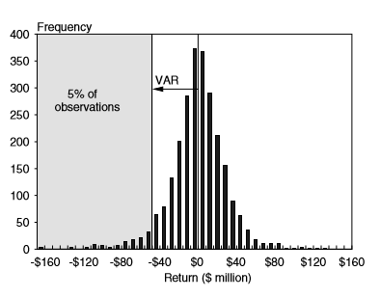
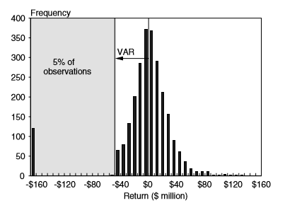
Risque de Marché | Les Mesures de Risque
Les limites de la VaR
7
7

Slide 8
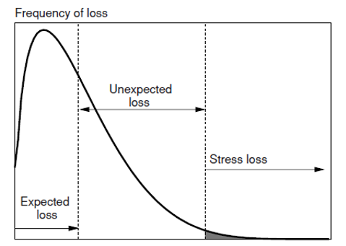
Risque de Crédit | Expected and Unexpected Loss
8
8

Slide 9
Risque de Crédit | Expected and Unexpected Loss
Expected credit loss (ECL): The expected credit loss represents the average credit loss. The pricing of the portfolio should be such that it covers the expected loss. In other words, the price should be advantageous enough to offset average credit losses. In the case of a bond, the price should be low enough, or the yield high enough, to compensate for expected losses.
Unexpected credit loss (UCL): The worst credit loss represents the loss that will not be exceeded at some level of confidence, typically 99.9%. This is basically the quantile of the distribution. Taking the deviation from the expected loss gives the unexpected credit loss. The institution should have enough equity capital to cover the unexpected loss. Focusing only on the default variables, the UCL depends on both default probabilities and default correlations.
9
9

Slide 10
Risque de Crédit| Les Mesures de Risque
VaR
Avantages
Limites
Largement accepté par les régulateurs
Facile à comprendre
Exprime le risque en une simple valeur
Utile pour la comparaison des risques des portefeuilles, composantes du portefeuille et les unités opérationnelles.
Subjective dans le sens où l’horizon et le niveau de confiance sont choisies par l’utilisateur
Très sensible à la méthode d’estimation et aux hypothèses utilisées.
Ignore la distribution des pertes au-delà de la VaR
10
10

Slide 11
Risque de Crédit | Capital et provisions
Comparaison
Capital Réglementaire
Capital Economique
Provisions
Unexpected Loss
Accords de Bâle: Pillier I
Modèle réglementaire pour le calcul du RWA
Unexpected Loss
Accords de Bâle: Pillier II
ICAAP: Internal Capital Adequacy Assessment Process
Modèles internes propres
Expected Loss
Calcul des provisions
Normes comptables IFRS 9
Différence avec les paramètres (PD, LGD) bâlois
11
11

Slide 12
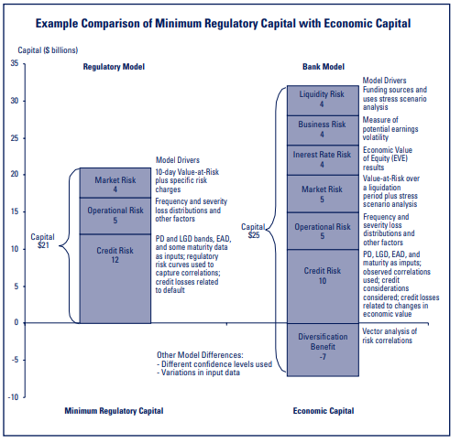

Risque de Crédit | Capital et provisions
Minimum Total Capital Ratio remains at 8%. The addition of the capital conservation buffer increases the total amount of capital a financial institution must hold to 10.5% of risk-weighted assets, of which 8.5% must be tier 1 capital. Tier 2 capital instruments are harmonized and tier 3 capital is abolished.
12
12

Slide 13
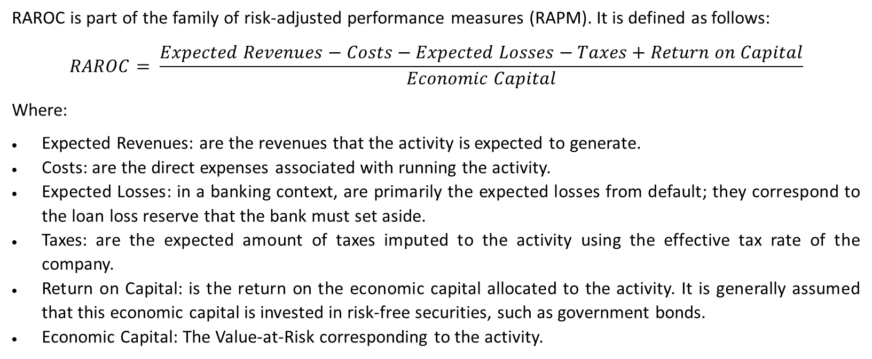
Risque de Crédit | RAROC
RAROC: Risk Adjusted Return On Capital
RAROC is part of the family of risk-adjusted performance measures (RAPM). It is defined as follows:
$$RAROC= \frac{Expected Revenues−Costs−Expected Losses−Taxes+Return on Capital}{Economic Capital}$$
Where:
Expected Revenues: are the revenues that the activity is expected to generate.
Costs: are the direct expenses associated with running the activity.
Expected Losses: in a banking context, are primarily the expected losses from default; they correspond to the loan loss reserve that the bank must set aside.
Taxes: are the expected amount of taxes imputed to the activity using the effective tax rate of the company.
Return on Capital: is the return on the economic capital allocated to the activity. It is generally assumed that this economic capital is invested in risk-free securities, such as government bonds.
Economic Capital: The Value-at-Risk corresponding to the activity.
13
13

Slide 14
Risque de Crédit | RAROC
RAROC: Risk Adjusted Return On Capital
The RAROC, and more generally Risk-Adjusted Performance Measures are generally used for the following purposes:
Performance measurement and incentive compensation at the firm, business unit, and individual level. Given that different projects have different risks, it is not sufficient to compare their returns. We can use RAROC to compare the profitability of different projects with different risk profile in a meaningful way (see example).
Active portfolio management for entry/exit decisions: The decision to enter or to exit a particular business should be based on both risk-adjusted performance measurement and the “risk diversification effect” of the decision.
Pricing transactions: Economic capital numbers can be used to calculate risk-based pricing for individual transactions. Risk-based pricing is attractive because it ensures that a firm is compensated for the economic risk generated by a transaction.
14
14

Slide 15
Risque de Crédit | RAROC
RAROC: Risk Adjusted Return On Capital
Hurdle Rate and Capital Budgeting
When a firm is considering investing in a business or closing down an activity, it computes the after-tax RAROC for the business or activity and compares it to the firm’s hurdle rate. In theory, the firm can then apply a simple decision rule:
If the RAROC Ratio is greater than the hurdle rate, the activity is deemed to add value to the firm.
In the opposite case, the activity is deemed to destroy value to the firm and should, in theory be closed down or the project rejected.
Most firms use a single hurdle rate for all businesses activities: the after-tax weighted-average cost of equity capital.
15
15

Slide 16
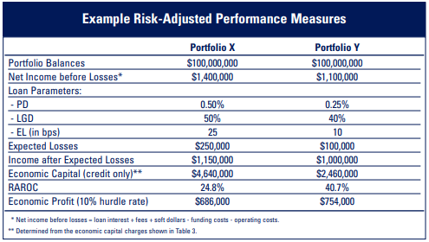
Risque de Crédit | RAROC
Exemple 1
16
16

Slide 17
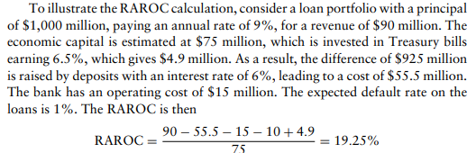
Risque de Crédit | RAROC
Exemple 2
17
17

Slide 18
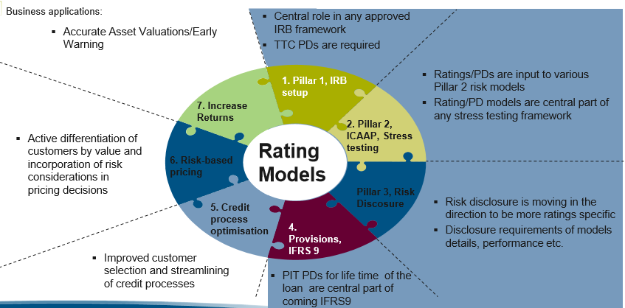
Risque de Crédit | Modèles de risque de crédit
18
18

Slide 19
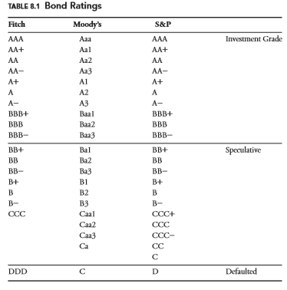
Risque de Crédit | Credit Ratings
19
19

Slide 20
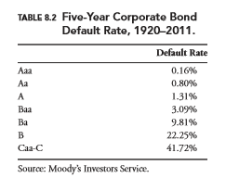
Risque de Crédit | Credit Ratings
20
20

Slide 21
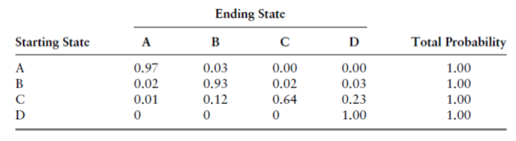
Risque de Crédit | Matrices de Transition
21
21

Slide 22
Risque de Crédit | Matrices de Transition
A ratings transition matrix provides the probability that a bond’s rating will change or stay the same over a given time period, given its rating at the start of that period.
The transition matrix gives the probability of moving to one rating conditional on the rating at the beginning of the period. The usual assumption is that these moves follow a Markov process, or that migrations across states are independent from one period to the next.
A Markov chain describes a stochastic process where the conditional distribution, given today’s value, is constant over time. Only present values are relevant.
22
22

Slide 23
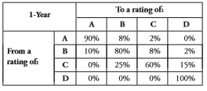
Risque de Crédit | Matrices de Transition
Consider the following transition matrix:
In this example, a B-rated bond has a 2% probability of defaulting over the course of one year. Now, we would like to know the default probability over 2 years?
23
23

Slide 24
Risque de Crédit | Matrices de Transition
To correctly calculate the probability of default over 2 years, we need to consider all the possible paths that a B-rated bond could take to default. Over two years, there are four ways in which the bond could default:
It could migrate to A in the first year and then default the second year.
It could remain at B the first year and then default in the second year.
It could migrate to C and then default in the second year.
It could default the first year and stay defaulted.
24
24

Slide 25
Risque de Crédit | Matrices de Transition
The details of computation of corresponding probabilities for each of these possible situations are as follows:
Transition Scenario | Probability
1. B → A → D | 10% × 0% = 0%
2. B → B → D | 80% × 2% = 1.6%
3. B → C → D | 8% × 15% = 1.2%
3. B → D → D | 2% × 100% = 2%
Total (2 years PD) | 4.8%
25
25

Slide 26

Risque de Crédit | Matrices de Transition
We calculate the entire-years transition matrix by multiplying the one-year matrix by itself. If T₁ is the one-year transition matrix and T₂ is the two-years transition matrix, then:
We can generalize this formula. To calculate the n-year transition matrix, we simply raise the T₁ to the n^{th} power, that is:
26
26

Slide 27
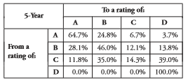
Risque de Crédit | Matrices de Transition
In our example, applying this formula, we can obtain the 5-years transition matrix as follows:
27
27

Slide 28
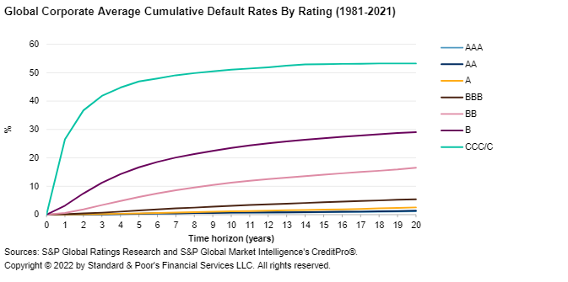
Risque de Crédit | PD Term Structure
28
28

Slide 29
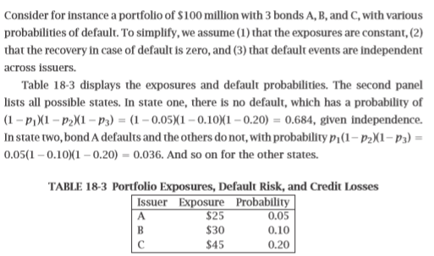
Risque de Crédit | Credit VaR
Exemple 1
29
29

Slide 30
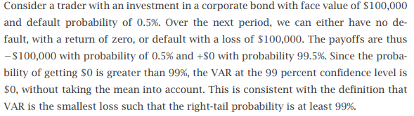
Risque de Crédit | Credit VaR
Exemple 2
30
30

Slide 31
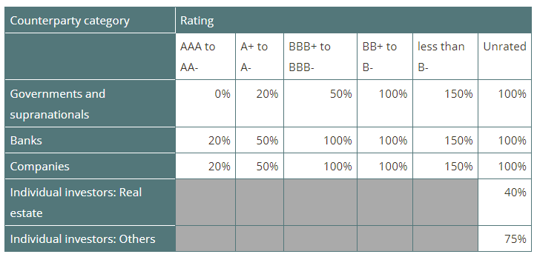
31
31

